Slide 1


Prediction of Loan Approval for Dream Housing Finance Company
MULI LILIAN MWIKALI

Slide 2
Business Problem
Dream Housing Finance company deals in all home loans. They have a presence across all urban, semi-urban, and rural areas. Customer-first applies for a home loan after that company validates the customer eligibility for a loan.
The company wants to automate the loan eligibility process (real-time) based on customer detail provided while filling the online application form. These details are Gender, Marital Status, Education, Number of Dependents, Income, Loan Amount, Credit History, and others. To automate this process, they have given a problem to identify the customer's segments, those are eligible for loan amount so that they can specifically target these customers.

Slide 3
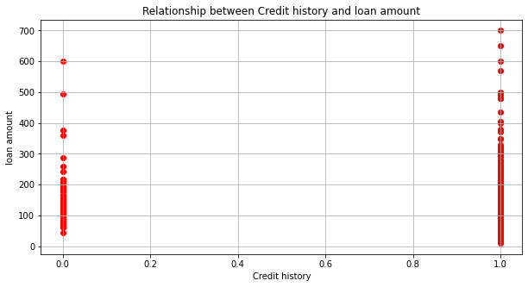
Relationship between credit history and loan amount
0 represents poor or no credit history and 1 indicates a good credit history
1. Distribution of loan amounts.
Most loans are around applicants with a credit history. This indicates that applicants with credit history tend to apply for loans of varying amounts.
There are fewer applicants with a credit history of 0 though they still apply for loans but the amounts vary widely.

Slide 4
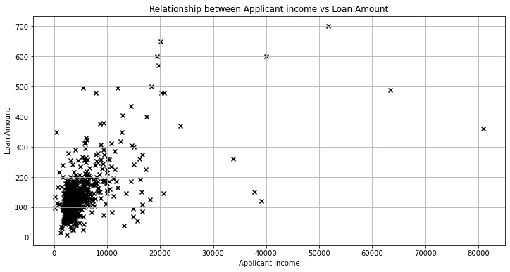
Relationship between Applicant income versus Loan Amount
1. Concentration of points.
There is a high concentration of points in the lower left corner of the graph indicating that most applicants have relatively lower income and are applying for smaller loan amounts respectively.
2. Outliers.
A few points are scattered from the main concentration of data where these outliers represent the applicants with high income who are requesting for large loan amounts.
3. Non-linear relationship.
The relationship between applicant income and loan amount doesn’t appear to be strictly linear.
4. Interpretation.
The graph suggests that while income is a factor in determination of loan amount ,other factors like credit history from our data are most likely to influence as well.

Slide 5
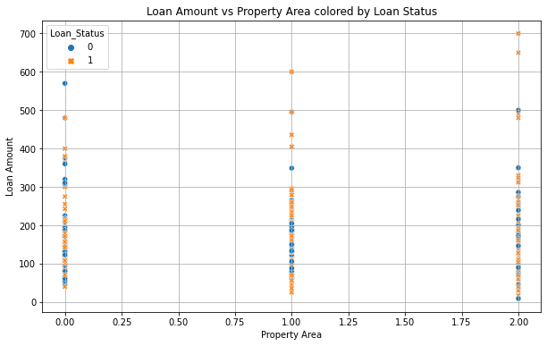
Loan Amount versus Property Area colored by Loan status
In some property areas, 1 which indicates semi urban and 2 for urban areas, loans seem to be approved more often which indicates a positive trend in loan eligibility for applicants requesting for loans in these property areas.
in each property category ,one can observe how the loan status (eligible or not eligible) is distributed.

Slide 6
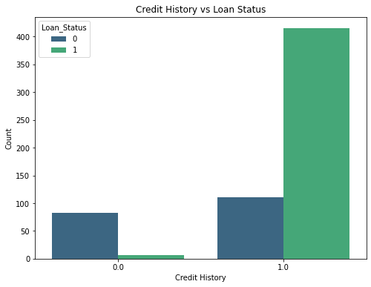
Credit History versus Loan Status
Credit History 0.0.This represents customers with a credit history of 0, meaning they likely have a poor or no credit history.
.The blue bar shows that among these customers, a larger number had their loans rejected (Loan Status = 0)..The green bar for Loan Status = 1 (loans approved) is very small, indicating very few loans were approved for customers with a credit history of 0.
Credit History 1.0:.This represents customers with a credit history of 1, indicating they have a good credit history.
The blue bar here is relatively small, showing that fewer customers with a good credit history had their loans rejected.
The green bar is significantly larger, showing that a majority of customers with a good credit history had their loans approved.
Conclusion:
Customers with a good credit history (1.0) are much more likely to have their loans approved than those with a poor or no credit history (0.0)
.This graph clearly shows that credit history is a strong factor influencing loan approval.

Slide 7
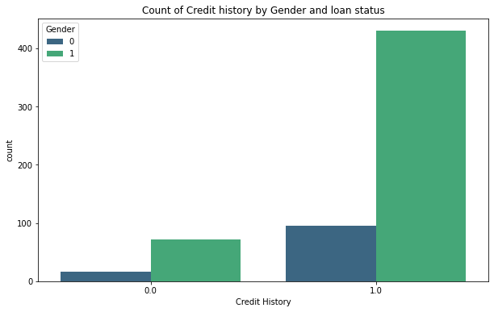
Count of credit history by gender and loan status
Credit history.
.1 is for a good credit history
.0 is for poor or no credit history
Gender.
.0 is for female
.1 is for male
Interpretation
ladies have a poor credit history compared to men and though the count of eligibility of the loan is a bit significant.
Male have both a high credit history and still the count of eligibility of the loan is high.

Slide 8
Recommendations
1. Targeted Outreach:
Based on the identified segments, develop targeted marketing strategies. For example, if high-income individuals with good credit history are more likely to be approved, tailor marketing efforts towards this segment.
2. Real-Time Automation:
Implement real-time scoring algorithms that consider Gender, Applicant Income, and Credit History to evaluate loan eligibility. Ensure that the scoring model is updated regularly with new data to maintain accuracy.
3. Bias and Fairness Review:
Regularly review and audit the automated system to ensure it is fair and unbiased. Ensure compliance with legal and ethical standards, particularly regarding gender and other sensitive attributes.
4. Segment Identification:
Gender: Identify if certain genders are more likely to be approved for loans. Ensure to consider this in a fair and unbiased manner, ensuring compliance with regulations.
Applicant Income: Segment applicants based on their income levels to determine which income brackets are more likely to receive loans. Higher income has indicated higher loan eligibility.
Credit History: Focus on applicants with good credit history as they are more likely to be eligible for loans. Create segments based on credit scores or history.

Slide 9
Conclusion
By focusing on Gender, Applicant Income, and Credit History, Dream Housing Finance can effectively streamline their loan eligibility process. The recommendation is to use machine learning models to identify and validate these factors' impact on loan approvals. Implementing a targeted approach based on these insights will enhance efficiency and accuracy in loan processing while ensuring fair and unbiased decision-making. Regularly updating the system and reviewing for biases will ensure long-term effectiveness and compliance.

